Slide 1
Chapter 01
Introduction to Knowledge Management

Slide 2
Objectives
What Is Knowledge (KM)?
What Is Knowledge Management?
History of Knowledge Management
Why Is KM Important Today?

Slide 3
What Is Knowledge Management (KM)?
There are many definitions
  The business perspective
  The intellectual or knowledge asset perspective
  The cognitive science or knowledge science perspective
  The library and information science perspective
  ….

Slide 4
What Is KM?
This makes it both easy and difficult to define what KM is-at one extreme
  KM encompasses everything to do with knowledge.
  KM is narrowly defined as an information technology system that dispenses organizational know-how.
KM is in fact both of these and many more. One of the few areas of consensus in the field is that KM is a highly multidisciplinary field.

Slide 5
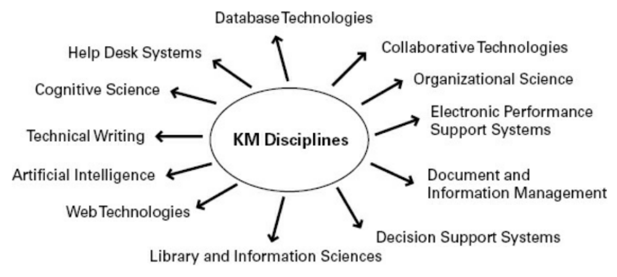
What Is KM?
Multidisciplinary Nature of KM

Slide 6

What Is KM?
“Knowledge management represents a deliberate and systematic approach to ensure the full utilization of the organization’s knowledge base, coupled with the potential of individual skills, competencies, thoughts, innovations, and ideas to create a more efficient and effective organization”

Slide 7
What Is KM?
“Knowledge management is the deliberate and systematic coordination of an organization’s people, technology, processes, and organizational structure in order to add value through reuse and innovation. This is achieved through the promotion of creating, sharing, and applying knowledge as well as through the feeding of valuable lessons learned and best
practices into corporate memory in order
to foster continued organizational learning”

Slide 8
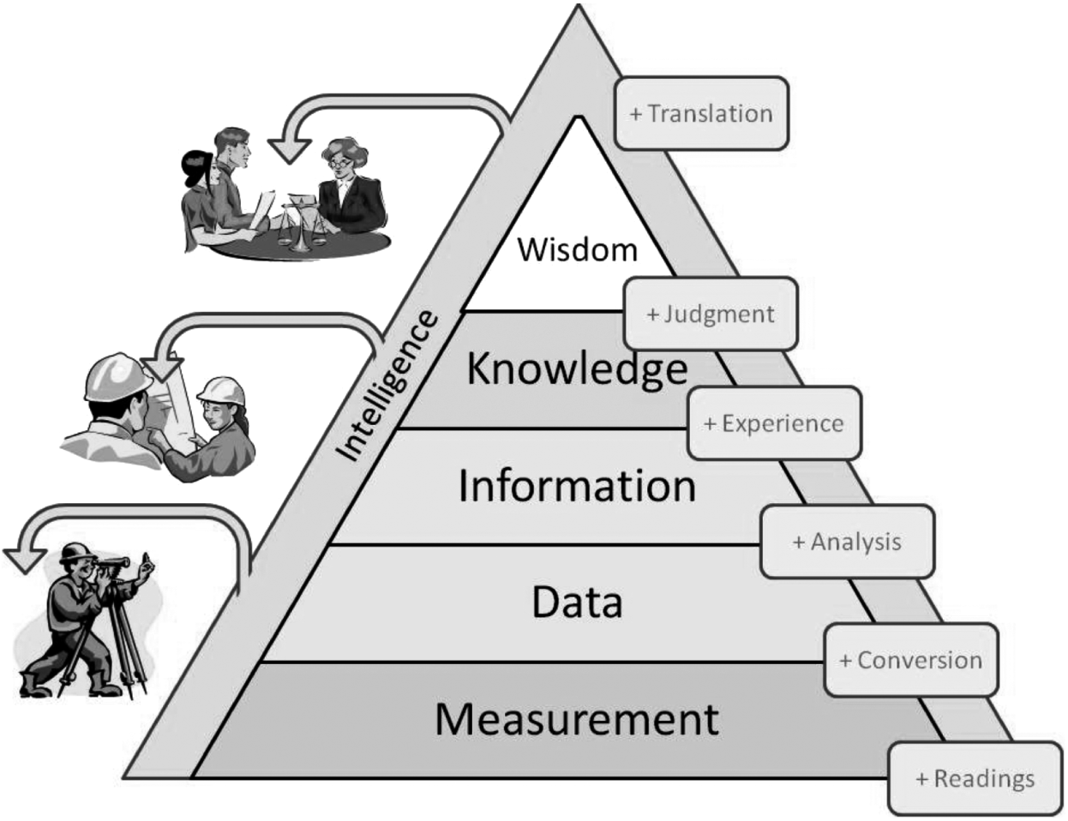
What Is KM?
  What Is Knowledge?
    Data: is directly observable or verifiable: a fact
    Information: represents analyzed data
    Knowledge: is a more subjective way of knowing, typically based on experiential or individual values, perceptions, and experience

Slide 9
What Is KM?
The Two Major Types of Knowledge: Tacit and Explicit
Properties of Knowledge
Concept Analysis Technique

Slide 10
The Two Major Types of Knowledge: Tacit and Explicit
  Tacit knowledge:
    Difficult to articulate and difficult to put into words, text, or drawings.
    Reside within the heads of “knowers”.
  Explicit knowledge:
    Content that has been captured in some tangible form such as words, audio recordings, or images.
    Reside within tangible or concrete media.

Slide 11
The Two Major Types of Knowledge: Tacit and Explicit
Properties of tacit knowledge | Properties of explicit knowledge
Ability to adapt, to deal with new and exceptional situations | Ability to disseminate, to reproduce, to access and re-apply throughout the organization
Expertise, know-how, know-why, and care why | Ability to teach, to train
Ability to collaborate, to share a vision, to transmit a culture | Ability to organize, to systematize; to translate a vision into a mission statement, into operational guidelines
Coaching and mentoring to transfer experiential knowledge on a one-to-one, face-to-face basis | Transfer knowledge via products, services, and documented processes

Slide 12
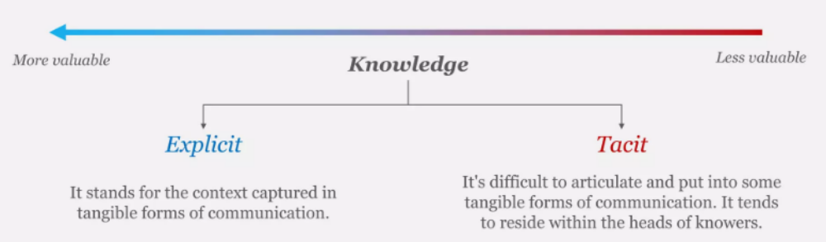
The Two Major Types of Knowledge: Tacit and Explicit

Slide 13
What Is KM?
The Two Major Types of Knowledge: Tacit and Explicit
Properties of Knowledge
Concept Analysis Technique

Slide 14
Properties of Knowledge
  Using knowledge does not consume it.
  Transferring knowledge does not result in losing it.
  Knowledge is abundant, but the ability to use it is scarce.
  Much of an organization’s valuable knowledge walks out the door at the end of the day.

Slide 15
What Is KM?
The Two Major Types of Knowledge: Tacit and Explicit
Properties of Knowledge
Concept Analysis Technique

Slide 16
Concept Analysis Technique
  Concept analysis is an established technique used in the social sciences (such as philosophy and education) in order to derive a formula that in turn can be used to generate definitions and descriptive phrases for highly complex terms
  Framework used in social science
  Useful in situation where the concept are complex and subjective

Slide 17
Concept Analysis Technique
  => A technique used to visually map out conceptual information in the process of defining a word. This is a technique derived from the fields of philosophy and science education and it is typically used in clearly defining complex, value-laden terms such as democracy or religion.

Slide 18
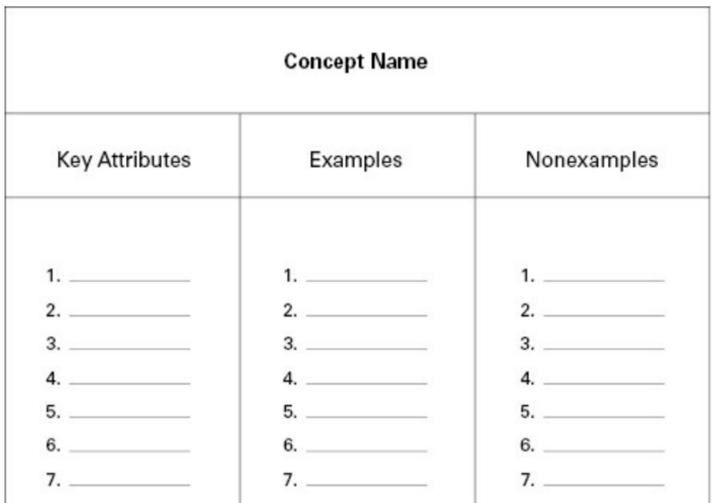
Concept Analysis Technique
    Key attributes: A list of key attributes that must be present in the definition, vision, or mission statement.
    Examples: A list of illustrative examples.
    Nonexamples: A list of illustrative non examples.

Slide 19
Concept Analysis Technique
The best way to organizations use this framework is within a group.
There is no right answer for “What is Knowledge Management to me?”. Each company needs to find its own
Each organization should define Knowledge Management in terms of the business objective. Concept analysis is one way of accomplishing this.

Slide 20
History of KM
The Entovation timeline
The various eras
Knowledge management milestones
From Physical Assets to Knowledge Assets
Organizational Perspectives on Knowledge Management

Slide 21
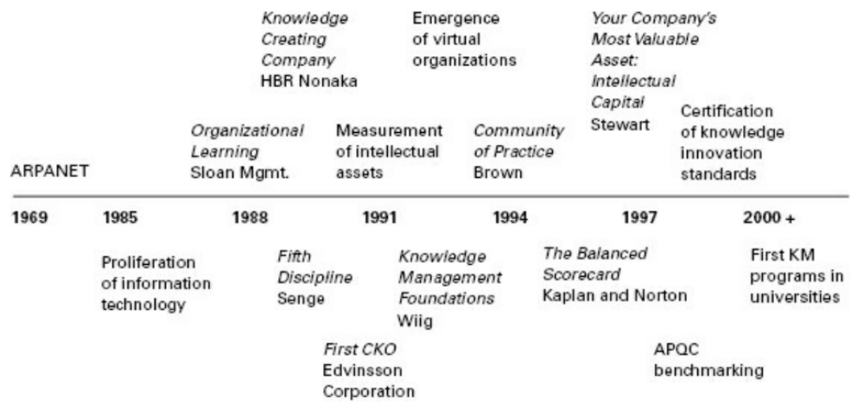
The Entovation timeline

Slide 22
History of KM
The Entovation timeline
The various eras
Knowledge management milestones
From Physical Assets to Knowledge Assets
Organizational Perspectives on Knowledge Management

Slide 23
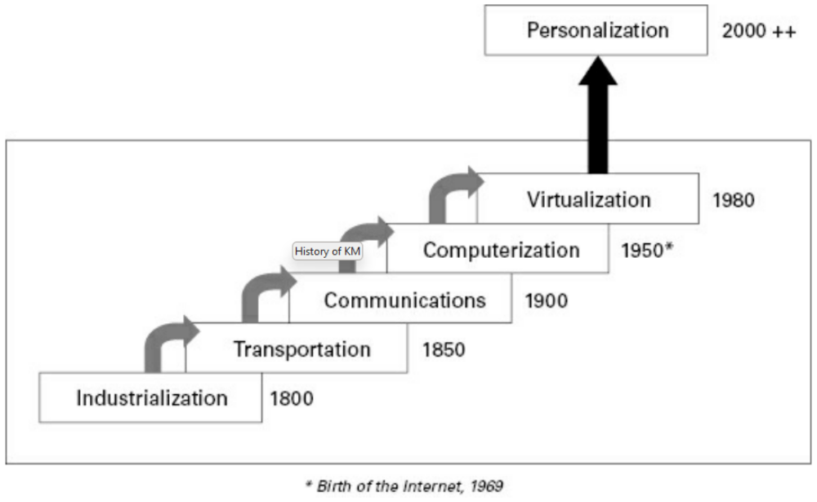
The various eras

Slide 24
History of KM
The Entovation timeline
The various eras
Knowledge management milestones
From Physical Assets to Knowledge Assets
Organizational Perspectives on Knowledge Management

Slide 25
Knowledge management milestones
Year | Entity | Event
1980 | DEC, CMU | XCON Expert System
1986 | Dr. K Wiig | Coined KM concept at UN
1989 | Consulting firms | Started internal KM projects
1991 | Nonaka and Takeuchi | HBR article
1993 | Dr. K Wiig | First KM book published
1994 | KM Network | First KM Conference
1998 | Davenport and Prusak | Publish Working Knowledge

Slide 26
Knowledge management milestones
Year | Entity | Event
Mid-1990s | Consulting firms | Start offering KM services
Late 1990s | Key vertical industries | Implement KM and start seeing benefits
2000–2003 | Academia | KM courses/programs in universities with KM texts
2003 to present | Professional and Academic Certification | KM degrees offered by universities, by professional institutions such as KMCI Knowledge Management Consortium International
2015 | KM added to ISO Standard 9001: 2015 | While not a KM standard per se, knowledge is recognized as an organizational resource to be managed in a new clause
2013 to present | AIIM Standards Board Committee on KM Education Standards | The Association for Information and Image Management Standards

Slide 27
History of KM
The Entovation timeline
The various eras
Knowledge management milestones
From Physical Assets to Knowledge Assets
Organizational Perspectives on Knowledge Management

Slide 28
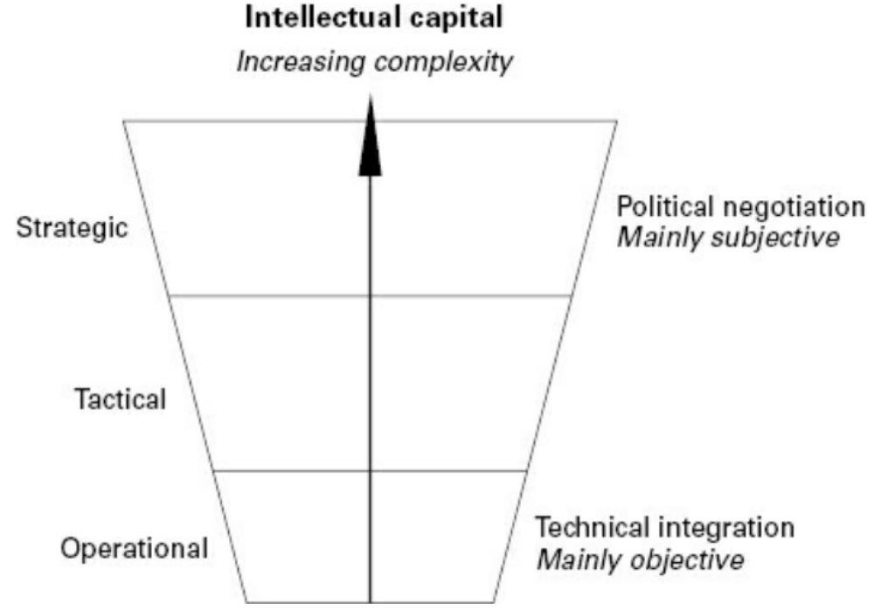
From Physical Assets to Knowledge Assets
    Strategic level:
      Establishing a “knowledge-oriented” mentality in a firm.
      Analyzing the current knowledge.
      Plaining the knowledge needed in the future.

Slide 29
From Physical Assets to Knowledge Assets
    Tactical level:
      Proper identification of the existing knowledge.
      Acquisition and proper archiving of new knowledge in organizational memories.
      Effective and efficient allocation of the knowledge with in a firm.
    Operational level:
      Ensuring that knowledge is used in everyday practice by those who need access to the right knowledge, at the right location.

Slide 30
History of KM
The Entovation timeline
The various eras
Knowledge management milestones
From Physical Assets to Knowledge Assets
Organizational Perspectives on Knowledge Management

Slide 31
Organizational Perspectives on Knowledge Management
  Business perspective: focusing on why, where, and to what extent the organization must invest in or exploit knowledge. Strategies, products and services, alliances, acquisitions, or divestments should be considered from knowledge-related points of view.
  Management perspective: focusing on determining, organizing, directing, facilitating, and monitoring knowledge-related practices and activities required to achieve the desired business strategies and objectives.
  Hands-on perspective: focusing on applying the expertise to conduct explicit knowledge-related work and tasks.

Slide 32
Why Is KM Important Today?
Globalization of business:
  Organizations today are more global—multisite, multilingual, and multicultural in nature.
Corporate amnesia:
  We are more mobile as a workforce, which creates problems of knowledge continuity for the organization and places continuous learning demands on the knowledge worker—we no longer expect to work for the same organization for our entire career.

Slide 33
Why Is KM Important Today?
Leaner organizations:
  We are doing more and we are doing it faster but we also need to work smarter as knowledge workers—increased pace and workload.
Technological advances:
  We are more connected—information technology advances have made connectivity not only ubiquitous but has radically changed expectations: we are expected to be on at all times and the turnaround time in responding is now measured in minutes not weeks.

Slide 34
Summary
Definition of key knowledge management concepts.
Learning a useful framework.
Description of the key roles and responsibilities.

Slide 35

Discussion / Homework / Team Activities
will be asked again before going through new content
Use concept analysis to clarify the following terms:
  a. Intellectual capital versus physical assets
  b. Tacit knowledge versus explicit knowledge c. Use versus reuse
“Knowledge management is not anything new.” Would you argue that this statement is largely true or false? Why or why not? Use historical antecedents to justify your arguments.
What are the three generations of knowledge management to date? What was the primary focus of each?
What are the different types of roles required for each of the above three generations?
What are the two major overarching goals for KM?
What are the key benefits of KM?

